Slide 1

Chapter 5
IP Addresses:
Classless Addressing
Objectives
Upon completion you will be able to:
Understand the concept of classless addressing
Be able to find the first and last address given an IP address
Be able to find the network address given a classless IP address
Be able to create subnets from a block of classless IP addresses
Understand address allocation and address aggregation
TCP/IP Protocol Suite

Slide 2
5.1 VARIABLE-LENGTH BLOCKS
In classless addressing variable-length blocks are assigned that belong to no class. In this architecture, the entire address space (2³² addresses) is divided into blocks of different sizes.
The topics discussed in this section include:
Restrictions
Finding the Block
Granted Block
TCP/IP Protocol Suite

Slide 3
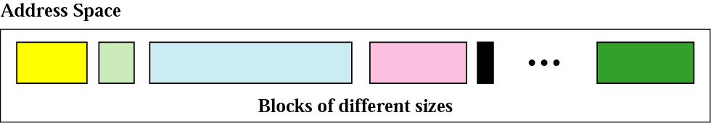
Figure 5.1 Variable-length blocks
TCP/IP Protocol Suite

Slide 4
Example 1
Which of the following can be the beginning address of a block that contains 16 addresses?
a. 205.16.37.32 b.190.16.42.44
c. 17.17.33.80 d.123.45.24.52
Solution
Only two are eligible (a and c). The address 205.16.37.32 is eligible because 32 is divisible by 16. The address 17.17.33.80 is eligible because 80 is divisible by 16.
TCP/IP Protocol Suite

Slide 5
Example 2
Which of the following can be the beginning address of a block that contains 256 addresses?
a.205.16.37.32 b.190.16.42.0
c.17.17.32.0 d.123.45.24.52
Solution
In this case, the right-most byte must be 0. As we mentioned in Chapter 4, the IP addresses use base 256 arithmetic. When the right-most byte is 0, the total address is divisible by 256. Only two addresses are eligible (b and c).
TCP/IP Protocol Suite

Slide 6
Example 3
Which of the following can be the beginning address of a block that contains 1024 addresses?
a. 205.16.37.32 b.190.16.42.0
c. 17.17.32.0 d.123.45.24.52
Solution
In this case, we need to check two bytes because
1024 = 4 × 256. The right-most byte must be divisible by 256. The second byte (from the right) must be divisible by 4. Only one address is eligible (c).
TCP/IP Protocol Suite

Slide 7
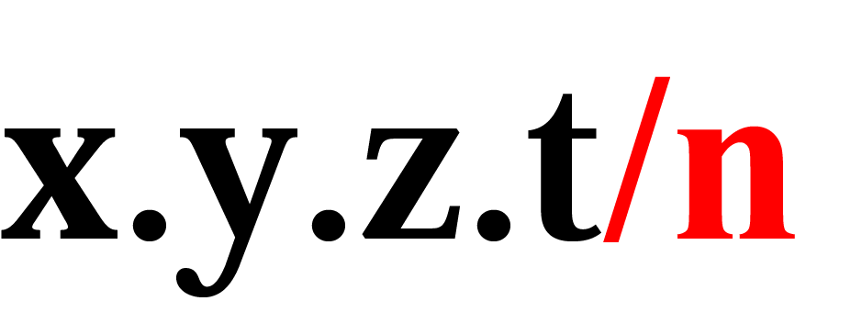
Figure 5.2 Format of classless addressing address
TCP/IP Protocol Suite

Slide 8
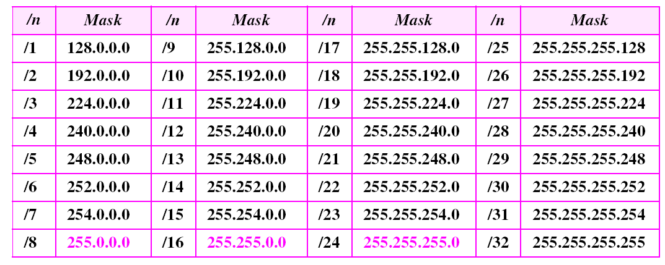
Table 5.1 Prefix lengths
TCP/IP Protocol Suite

Slide 9

Note:
Classful addressing is a special case of classless addressing.
TCP/IP Protocol Suite

Slide 10
Example 4
What is the first address in the block if one of the addresses is 167.199.170.82/27?
Solution
The prefix length is 27, which means that we must keep the first 27 bits as is and change the remaining bits (5) to 0s. The following shows the process:
Address in binary: 10100111 11000111 10101010 01010010
Keep the left 27 bits: 10100111 11000111 10101010 01000000
Result in CIDR notation: 167.199.170.64/27
TCP/IP Protocol Suite

Slide 11
Example 5
What is the first address in the block if one of the addresses is 140.120.84.24/20?
Solution
Figure 5.3 shows the solution. The first, second, and fourth bytes are easy; for the third byte we keep the bits corresponding to the number of 1s in that group. The first address is 140.120.80.0/20.
See Next Slide
TCP/IP Protocol Suite

Slide 12
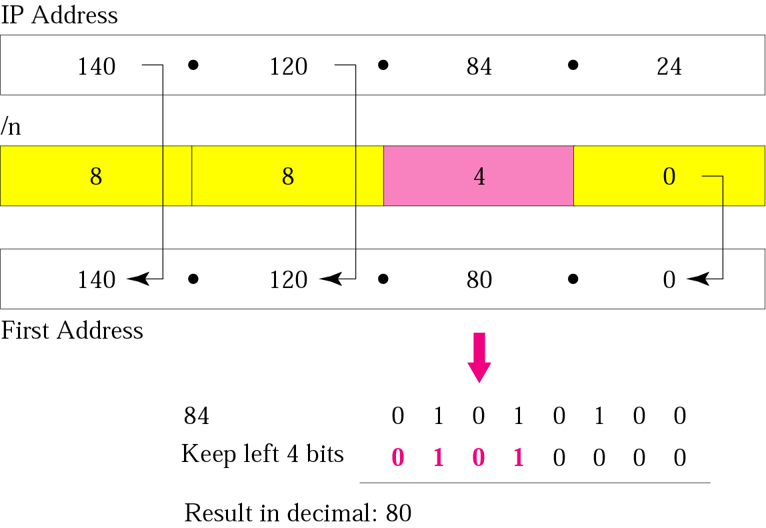
Figure 5.3 Example 5
TCP/IP Protocol Suite

Slide 13
Example 6
Find the first address in the block if one of the addresses is 140.120.84.24/20.
Solution
The first, second, and fourth bytes are as defined in the previous example. To find the third byte, we write 84 as the sum of powers of 2 and select only the leftmost 4 (m is 4) as shown in Figure 5.4. The first address is 140.120.80.0/20.
See Next Slide
TCP/IP Protocol Suite

Slide 14
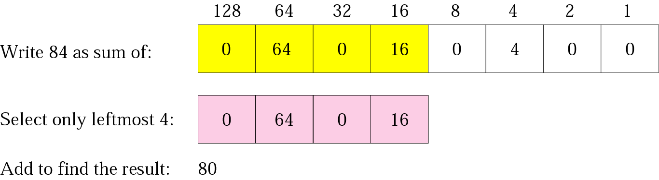
Figure 5.4 Example 6
TCP/IP Protocol Suite

Slide 15
Example 7
Find the number of addresses in the block if one of the addresses is 140.120.84.24/20.
Solution
The prefix length is 20. The number of addresses in the block is 2³²⁻²⁰ or 2¹² or 4096. Note that
this is a large block with 4096 addresses.
TCP/IP Protocol Suite

Slide 16
Example 8
Using the first method, find the last address in the block if one of the addresses is 140.120.84.24/20.
Solution
We found in the previous examples that the first address is 140.120.80.0/20 and the number of addresses is 4096. To find the last address, we need to add 4095 (4096 − 1) to the first address.
See Next Slide
TCP/IP Protocol Suite

Slide 17
Example 8 (Continued)
To keep the format in dotted-decimal notation, we need to represent 4095 in base 256 (see Appendix B) and do the calculation in base 256. We write 4095 as 15.255. We then add the first address to this number (in base 255) to obtain the last address as shown below:
140 . 120 . 80 . 0
15 . 255
-------------------------
140 . 120 . 95 . 255
The last address is 140.120.95.255/20.
TCP/IP Protocol Suite

Slide 18
Example 9
Using the second method, find the last address in the block if one of the addresses is 140.120.84.24/20.
Solution
The mask has twenty 1s and twelve 0s. The complement of the mask has twenty 0s and twelve 1s. In other words, the mask complement is
00000000 00000000 00001111 11111111
or 0.0.15.255. We add the mask complement to the beginning address to find the last address.
See Next Slide
TCP/IP Protocol Suite

Slide 19
Example 9 (Continued)
We add the mask complement to the beginning address to find the last address.
140 . 120 . 80 . 0
0 . 0 . 15 . 255
----------------------------
140 . 120 . 95 . 255
The last address is 140.120.95.255/20.
TCP/IP Protocol Suite

Slide 20
Example 10
Find the block if one of the addresses is 190.87.140.202/29.
Solution
We follow the procedure in the previous examples to find the first address, the number of addresses, and the last address. To find the first address, we notice that the mask (/29) has five 1s in the last byte. So we write the last byte as powers of 2 and retain only the leftmost five as shown below:
See Next Slide
TCP/IP Protocol Suite

Slide 21
Example 10 (Continued)
202 ➡ 128 + 64 + 0 + 0 + 8 + 0 + 2 + 0
The leftmost 5 numbers are ➡ 128 + 64 + 0 + 0 + 8
The first address is 190.87.140.200/29
The number of addresses is 2³²⁻²⁹ or 8. To find the last address, we use the complement of the mask. The mask has twenty-nine 1s; the complement has three 1s. The complement is 0.0.0.7. If we add this to the first address, we get 190.87.140.207/29. In other words, the first address is 190.87.140.200/29, the last address is 190.87.140.207/20. There are only 8 addresses in this block.
TCP/IP Protocol Suite

Slide 22
Example 11
Show a network configuration for the block in the previous example.
Solution
The organization that is granted the block in the previous example can assign the addresses in the block to the hosts in its network. However, the first address needs to be used as the network address and the last address is kept as a special address (limited broadcast address). Figure 5.5 shows how the block can be used by an organization. Note that the last address ends with 207, which is different from the 255 seen in classful addressing.
See Next Slide
TCP/IP Protocol Suite

Slide 23
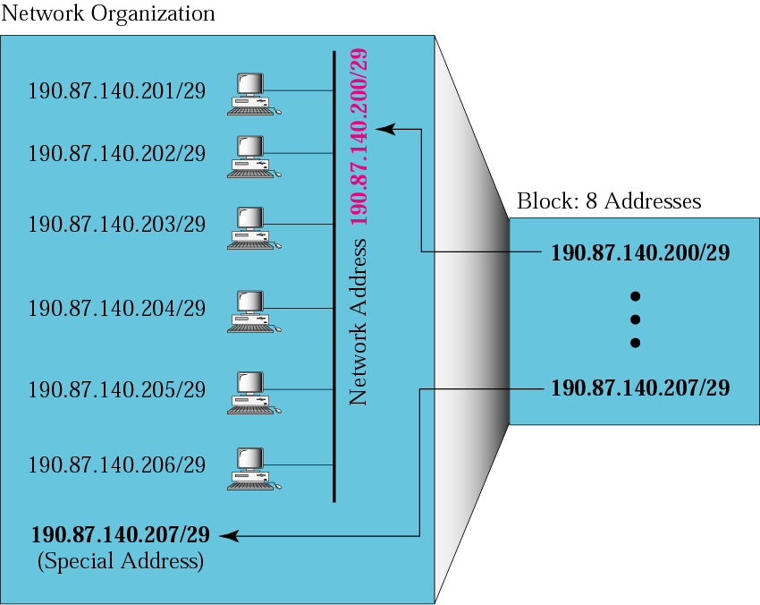
Figure 5.5 Example 11
TCP/IP Protocol Suite

Slide 24
Note:
In classless addressing, the last address in the block does not necessarily end in 255.
TCP/IP Protocol Suite

Slide 25
Note:
In CIDR notation, the block granted is defined by the first address and the prefix length.
TCP/IP Protocol Suite

Slide 26
5.2 SUBNETTING
When an organization is granted a block of addresses, it can create subnets to meet its needs. The prefix length increases to define the subnet prefix length.
The topics discussed in this section include:
Finding the Subnet Mask
Finding the Subnet Addresses
Variable-Length Subnets
TCP/IP Protocol Suite

Slide 27
Note:
In fixed-length subnetting, the number of subnets is a power of 2.
TCP/IP Protocol Suite

Slide 28
Example 12
An organization is granted the block 130.34.12.64/26. The organization needs 4 subnets. What is the subnet prefix length?
Solution
We need 4 subnets, which means we need to add two more 1s (log₂ 4 = 2) to the site prefix. The subnet prefix is then /28.
TCP/IP Protocol Suite

Slide 29
Example 13
What are the subnet addresses and the range of addresses for each subnet in the previous example?
Solution
Figure 5.6 shows one configuration.
See Next Slide
TCP/IP Protocol Suite

Slide 30
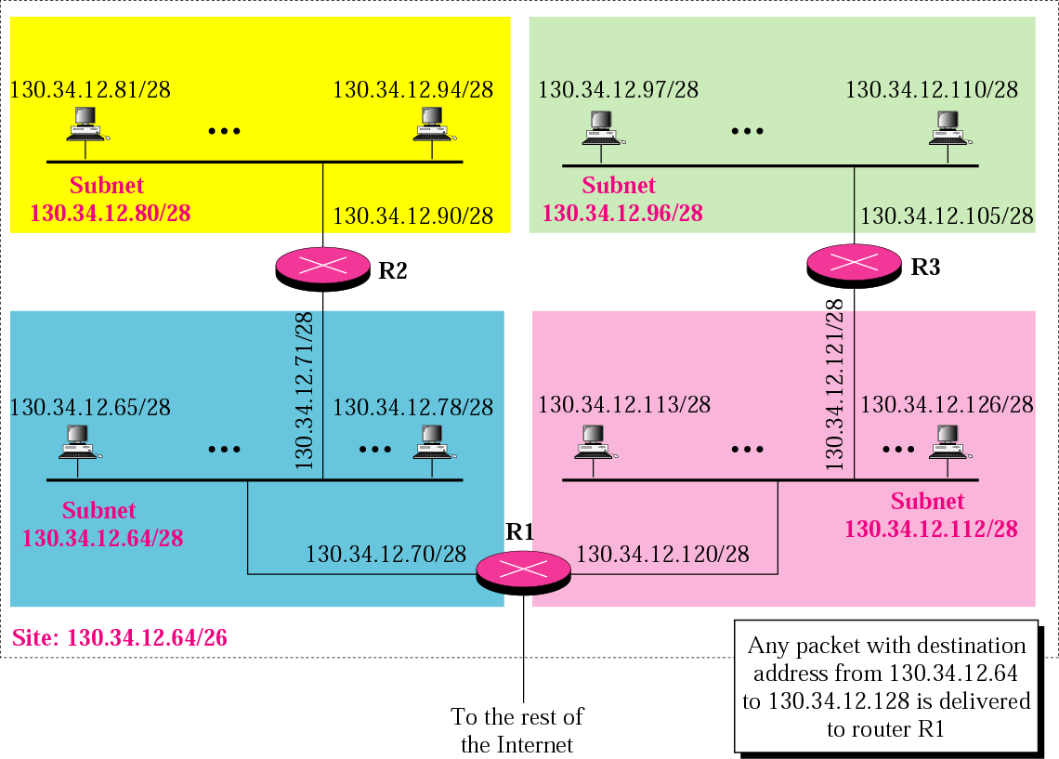
Figure 5.6 Example 13
TCP/IP Protocol Suite

Slide 31
Example 13 (Continued)
The site has 2³²⁻²⁶ = 64 addresses. Each subnet has 2^{32–28} = 16 addresses. Now let us find the first and last address in each subnet.
1. The first address in the first subnet is 130.34.12.64/28, using the procedure we showed in the previous examples. Note that the first address of the first subnet is the first address of the block. The last address of the subnet can be found by adding 15 (16 −1) to the first address. The last address is 130.34.12.79/28.
See Next Slide
TCP/IP Protocol Suite

Slide 32
Example 13 (Continued)
2.The first address in the second subnet is 130.34.12.80/28; it is found by adding 1 to the last address of the previous subnet. Again adding 15 to the first address, we obtain the last address, 130.34.12.95/28.
3. Similarly, we find the first address of the third subnet to be 130.34.12.96/28 and the last to be 130.34.12.111/28.
4. Similarly, we find the first address of the fourth subnet to be 130.34.12.112/28 and the last to be 130.34.12.127/28.
TCP/IP Protocol Suite

Slide 33
Example 14
An organization is granted a block of addresses with the beginning address 14.24.74.0/24. There are 2³²⁻²⁴= 256 addresses in this block. The organization needs to have 11 subnets as shown below:
a. two subnets, each with 64 addresses.
b. two subnets, each with 32 addresses.
c. three subnets, each with 16 addresses.
d. four subnets, each with 4 addresses.
Design the subnets.
See Next Slide For One Solution
TCP/IP Protocol Suite

Slide 34
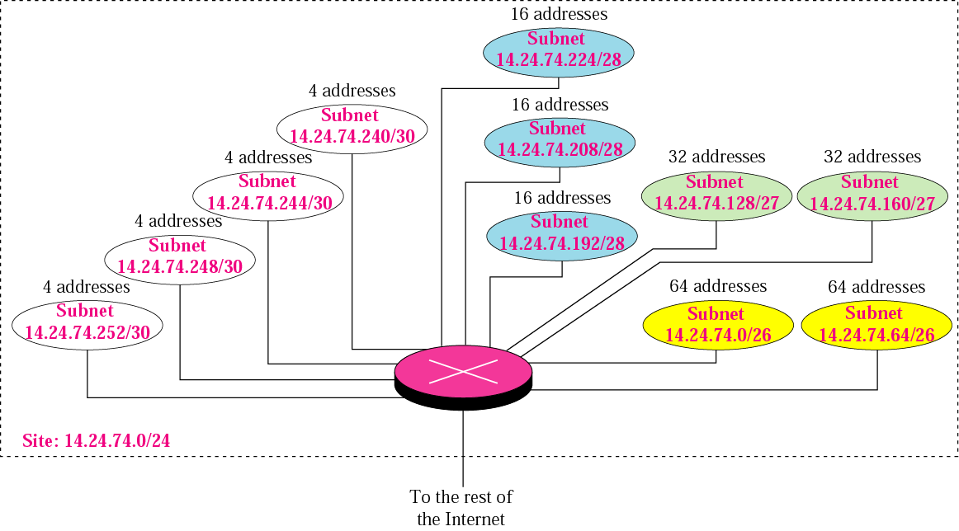
Figure 5.7 Example 14
TCP/IP Protocol Suite

Slide 35
Example 14 (Continuted)
1. We use the first 128 addresses for the first two subnets, each with 64 addresses. Note that the mask for each network is /26. The subnet address for each subnet is given in the figure.
2. We use the next 64 addresses for the next two subnets, each with 32 addresses. Note that the mask for each network is /27. The subnet address for each subnet is given in the figure.
See Next Slide
TCP/IP Protocol Suite

Slide 36
Example 14 (Continuted)
3. We use the next 48 addresses for the next three subnets, each with 16 addresses. Note that the mask for each network is /28. The subnet address for each subnet is given in the figure.
4. We use the last 16 addresses for the last four subnets, each with 4 addresses. Note that the mask for each network is /30. The subnet address for each subnet is given in the figure.
TCP/IP Protocol Suite

Slide 37
Example 15
As another example, assume a company has three offices: Central, East, and West. The Central office is connected to the East and West offices via private, point-to-point WAN lines. The company is granted a block of 64 addresses with the beginning address 70.12.100.128/26. The management has decided to allocate 32 addresses for the Central office and divides the rest of addresses between the two offices. Figure 5.8 shows the configuration designed by the management.
See Next Slide
TCP/IP Protocol Suite

Slide 38
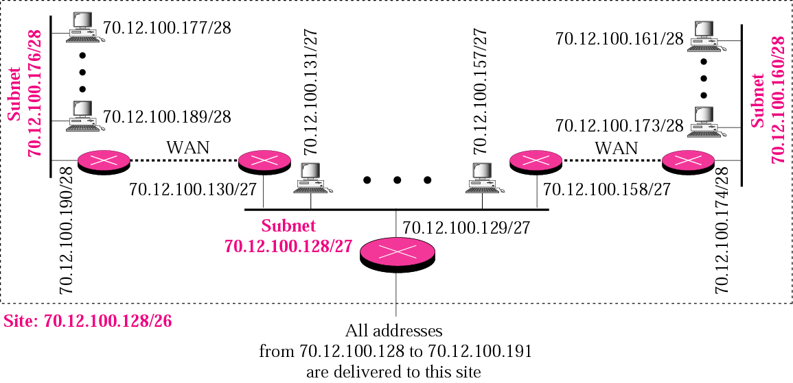
Figure 5.8 Example 15
TCP/IP Protocol Suite

Slide 39
Example 15 (Continued)
The company will have three subnets, one at Central, one at East, and one at West. The following lists the subblocks allocated for each network:
a. The Central office uses the network address 70.12.100.128/27. This is the first address, and the mask /27 shows that there are 32 addresses in this network. Note that three of these addresses are used for the routers and the company has reserved the last address in the sub-block. The addresses in this subnet are 70.12.100.128/27 to 70.12.100.159/27. Note that the interface of the router that connects the Central subnet to the WAN needs no address because it is a point-to-point connection.
See Next Slide
TCP/IP Protocol Suite

Slide 40
Example 15 (Continued)
b. The West office uses the network address 70.12.100.160/28. The mask /28 shows that there are only 16 addresses in this network. Note that one of these addresses is used for the router and the company has reserved the last address in the sub-block. The addresses in this subnet are 70.12.100.160/28 to 70.12.100.175/28. Note also that the interface of the router that connects the West subnet to the WAN needs no address because it is a point-to- point connection.
See Next Slide
TCP/IP Protocol Suite

Slide 41
Example 15 (Continued)
c. The East office uses the network address 70.12.100.176/28. The mask /28 shows that there are only 16 addresses in this network. Note that one of these addresses is used for the router and the company has reserved the last address in the sub-block. The addresses in. this subnet are 70.12.100.176/28 to 70.12.100.191/28. Note also that the interface of the router that connects the East subnet to the WAN needs no address because it is a point-to-point connection.
TCP/IP Protocol Suite

Slide 42
5.3 ADDRESS ALLOCATION
Address allocation is the responsibility of a global authority called the Internet Corporation for Assigned Names and Addresses (ICANN). It usually assigns a large block of addresses to an ISP to be distributed to its Internet users.
TCP/IP Protocol Suite

Slide 43
Example 16
An ISP is granted a block of addresses starting with 190.100.0.0/16 (65,536 addresses). The ISP needs to distribute these addresses to three groups of customers as follows:
a. The first group has 64 customers; each needs 256 addresses.
b. The second group has 128 customers; each needs 128 addresses
c. The third group has 128 customers; each needs 64 addresses.
See Next Slide
TCP/IP Protocol Suite

Slide 44
Example 16 (Continued)
Design the subblocks and find out how many addresses are still available after these allocations.
Solution
Figure 5.9 shows the situation.
See Next Slide
TCP/IP Protocol Suite

Slide 45
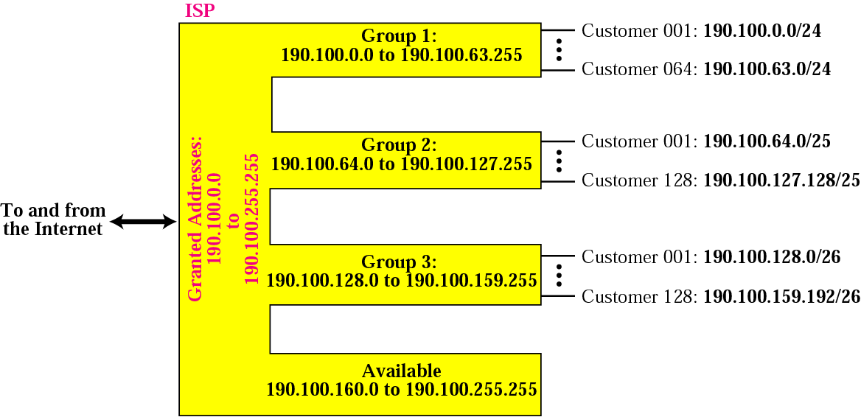
Figure 5.9 Example 16
TCP/IP Protocol Suite

Slide 46
Example 16 (Continued)
Group 1
For this group, each customer needs 256 addresses. This means the suffix length is 8 (2⁸ =256). The prefix length is then 32 − 8 = 24. The addresses are:
1st Customer 190.100.0.0/24 190.100.0.255/24
2nd Customer 190.100.1.0/24 190.100.1.255/24
. . .
64th Customer 190.100.63.0/24 190.100.63.255/24
Total = 64 × 256 = 16,384
See Next Slide
TCP/IP Protocol Suite

Slide 47
Example 16 (Continued)
Group 2
For this group, each customer needs 128 addresses. This means the suffix length is 7 (2⁷ =128). The prefix length is then 32 − 7 = 25. The addresses are:
1st Customer 190.100.64.0/25 190.100.64.127/25
2nd Customer 190.100.64.128/25 190.100.64.255/25
· · ·
128th Customer 190.100.127.128/25 190.100.127.255/25
Total = 128 × 128 = 16,384
See Next Slide
TCP/IP Protocol Suite

Slide 48
Example 16 (continued)
Group 3
For this group, each customer needs 64 addresses. This means the suffix length is 6 (26 = 64). The prefix length is then 32 − 6 = 26. The addresses are:
1st Customer 190.100.128.0/26 190.100.128.63/26
2nd Customer 190.100.128.64/26 190.100.128.127/26
· · ·
128th Customer 190.100.159.192/26 190.100.159.255/26
Total = 128 × 64 = 8,192
See Next Slide
TCP/IP Protocol Suite

Slide 49
Example 16 (continued)
Number of granted addresses to the ISP: 65,536
Number of allocated addresses by the ISP: 40,960
Number of available addresses: 24,576
TCP/IP Protocol Suite

